Slide 1
Pulley

Slide 2
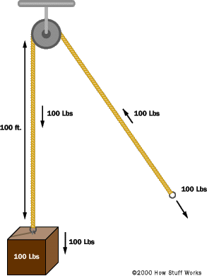
Pulley system
A pulley system is made up of wheels with grooves (called pulleys) and a rope or cable. It helps lift heavy things by spreading the weight over several ropes and pulleys. When you pull on the rope, the object attached to the other end moves up. Pulleys make lifting easier because they reduce the amount of force you need to use.

Slide 3
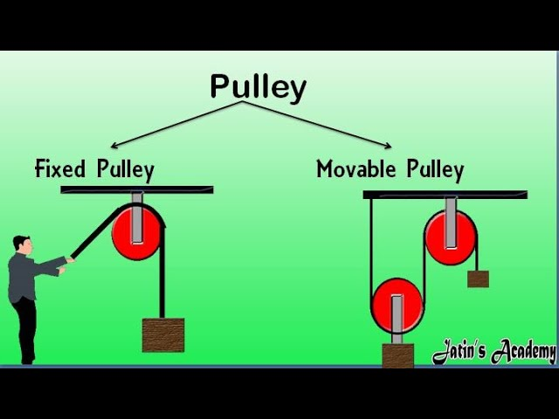
Fixed pulley and movable pulley
A fixed pulley is a type of pulley where the center axle stays in one place. It changes the direction of the force you apply but doesn't change how hard you have to pull. When you pull the rope, the distance the rope moves is the same as how far the object moves up.
A movable pulley is a pulley where the central axle moves along with the object being pulled. It doesn't change the direction of force but does reduce the amount of force needed. The distance the effort side of a movable pulley moves up is twice the distance the object moves up.

Slide 4
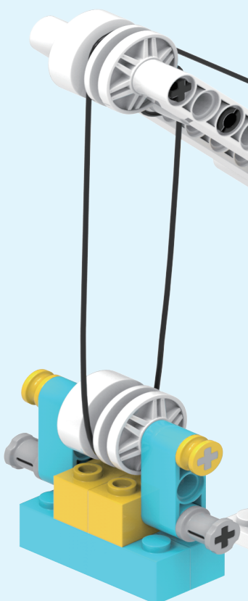
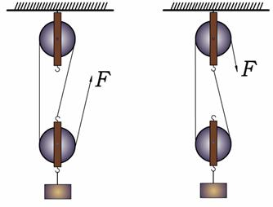
Pulley system
A pulley system is made up of several movable and fixed pulleys. It uses both types to change the direction of force and make it easier to move objects. Using a pulley system saves effort but requires pulling over a longer distance. The side where you apply force moves much farther than the heavy object being lifted.

