Slide 1
Ratchet

Slide 2
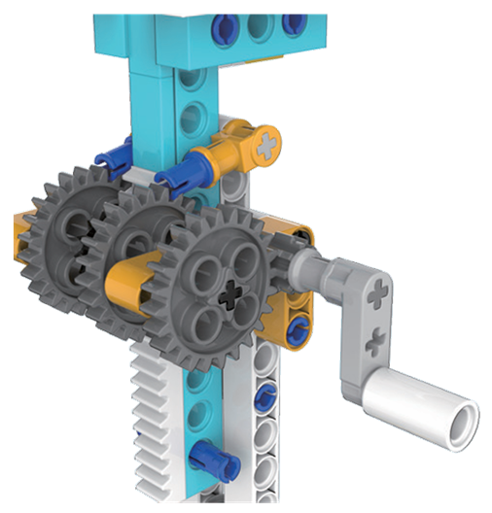
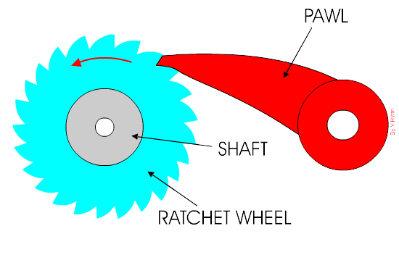
Review:Ratchet Mechanism
A ratchet mechanism is based on a wheel that has teeth cut out of it and a pawl that follows as the wheel turns. The pawl prevent the ratchet from reversing

