Slide 1
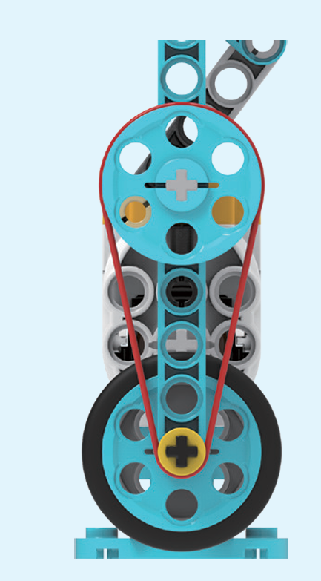
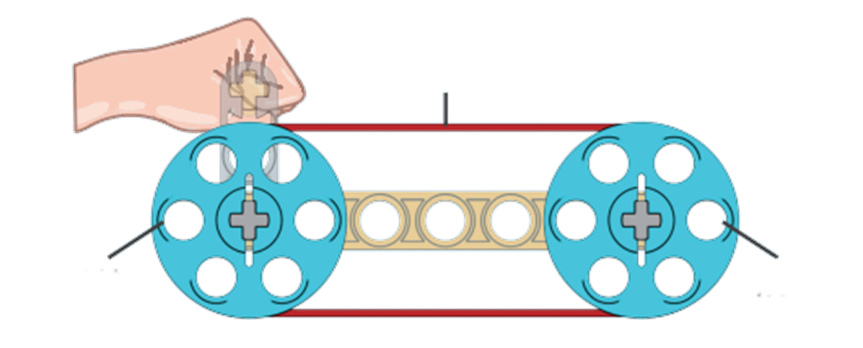
Belt Driven
A belt-driven machine uses a belt to connect two spinning wheels or pulleys. When one wheel turns, the belt moves and makes the other wheel spin too! It’s like how a bike chain helps the wheels move when you pedal. Belt drives are used in lots of machines, like fans, washing machines, and even cars, to help parts work together smoothly and quickly.
Belt
Driving pulley
Driven pulley

Slide 2
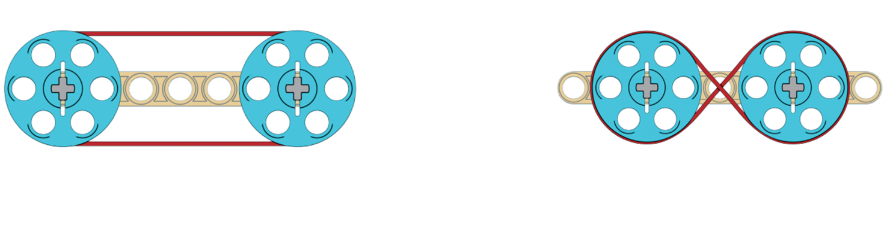
Belt Driven
Belt drive includes open belt drive and crossed belt drive
Can you identify the following belt drive?

Slide 3
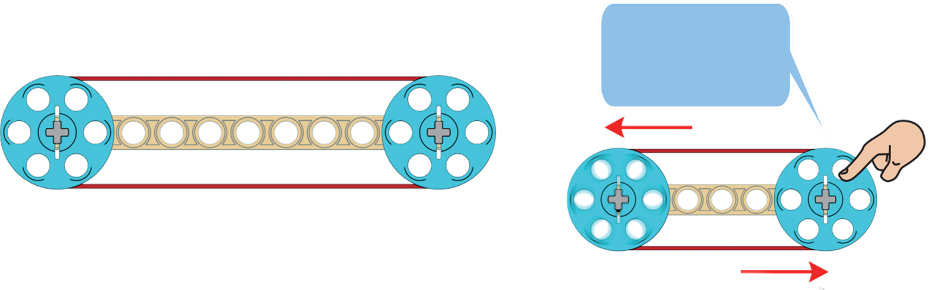
Belt Driven
Belt transmission can achieve long-distance power transfer. When sudden external force is applied or there is an abrupt change in speed, belt transmission can protect the machinery and prevent damage to its components.
By holding the pulley with your hand, the belt slips while the machine keeps running
Long distance power transfer
Belt slipping to protect the pulley/machinery

Slide 4
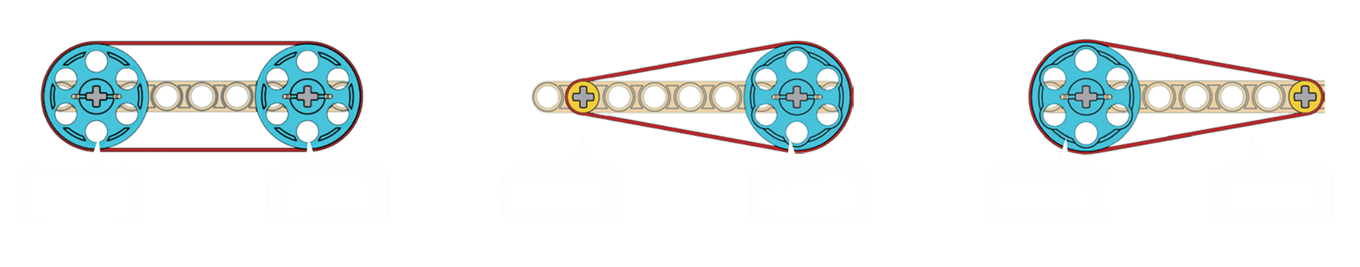
Review: Analysis of the principle of belt drive
Driving wheel
Driven wheel
Driving wheel
Driven wheel
Driving wheel
Driven wheel
When the driving wheel and driven wheel are the same size, speed and force remain unchanged
When the driving wheel is smaller than the driven wheel, speed decreases, and force increases
When the driving wheel is larger than the driven wheel, speed increases, and force decreases

Slide 5
Belt Driven
Belt drive includes open belt drive and crossed belt drive
Can you identify the following belt drive?

