Slide 1
Crank mechanism

Slide 2
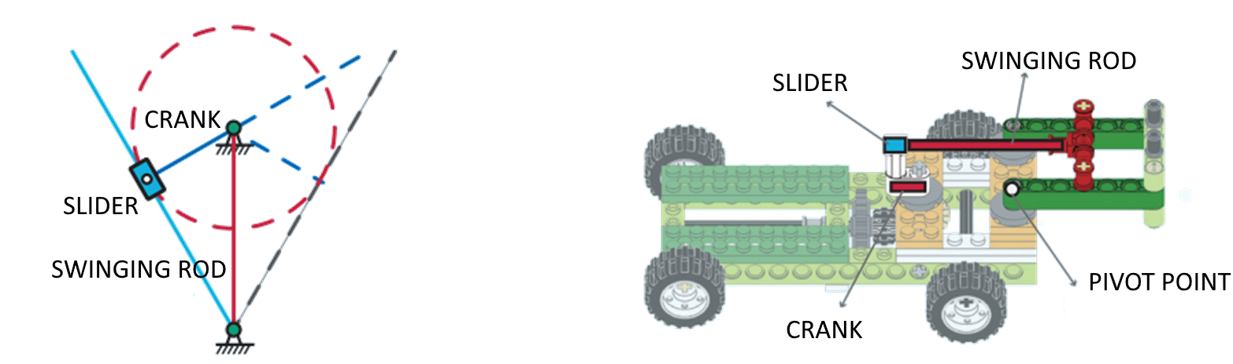
Swing Linkage Mechanism
The swing linkage mechanism is like a special arm that helps turn spinning motion into sliding motion!
When the crank (曲柄) spins, it moves the slider (滑块) back and forth in a straight line. The swinging rod (摆摆导杆) guides the slider to move smoothly, like drawing a straight line while your hand moves in a circle.
This system is often used in cars, engines, and robots to make parts move just the right way!

Slide 3
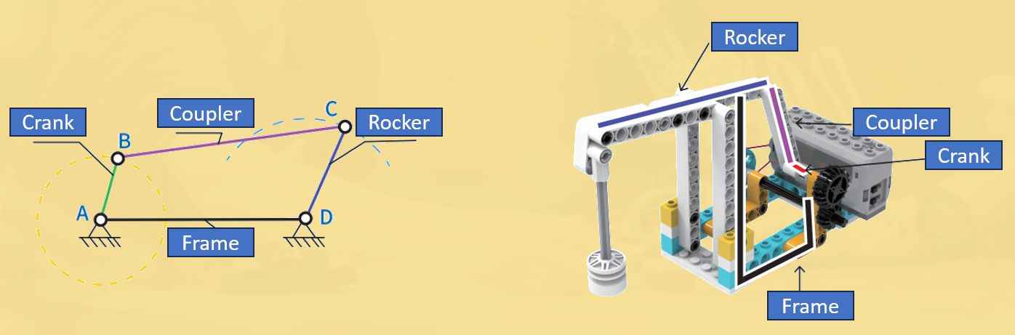
Deformation of crank rockers
A crank rocker mechanism is a hinged four-bar structure with one crank and one rocker. The crank is used as an active element with a rocker
motion, so that the circular motion is converted into a straight reciprocating motion.
The pump jack uses a crank rocker mechanism, but its crank and rocker are not on the same plane.

Slide 4
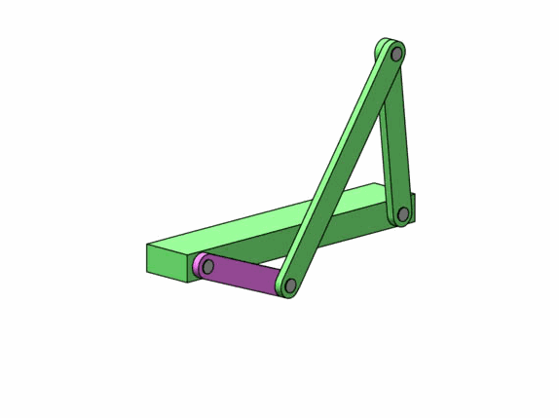
Movement of crank rockers
Rocker
Crank

Slide 5
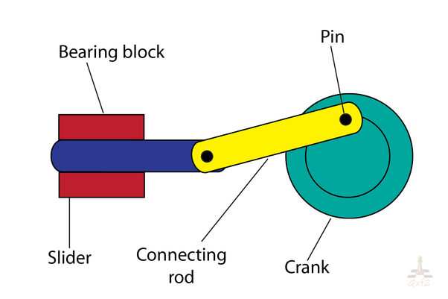
Summary
Crank mechanism
The crank rocker mechanism includes a crank and a rocker connected in a four-bar linkage. The crank rotates in a circular motion, while the rocker swings back and forth. When the crank drives, the rocker moves back and forth.

Slide 6
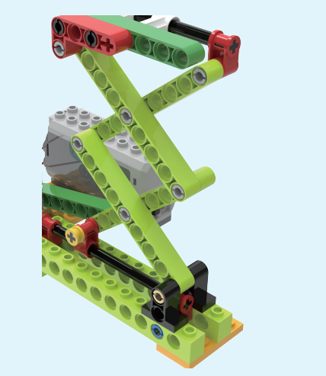
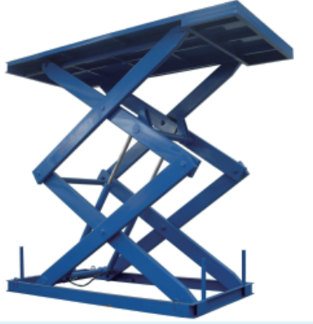
Scissor Mechanism
Have you seen a pair of scissors before?
A scissor lift uses a similar structure, called a scissor mechanism!
It works by using folding metal bars that make a shape like a big "X". This shape is part of a special square that can change size, which is called a deformable quadrilateral (don’t worry, it just means it can stretch or fold!).
When the bars fold together, the platform goes down.
When the bars open up, the platform lifts up high!
It’s a smart way to raise and lower things safely—just like scissors opening and closing!

Slide 7
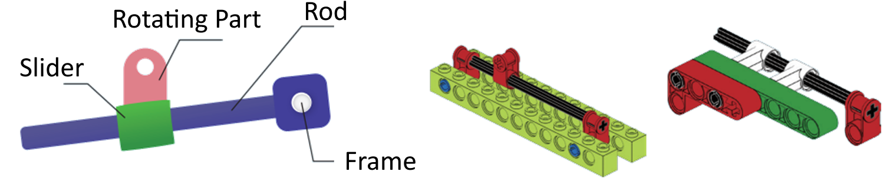
Slide Rod Mechanism?
The scissor lift uses a slide rod mechanism at both the top and bottom to help it move up and down smoothly!
A slide rod mechanism is made of four parts:
A slider (that moves back and forth)
A rod (that connects things)
A rotating part (that spins in circles)
And the frame (that holds everything)
When the rotating part spins steadily, it pushes and pulls the slider. That movement is passed along to the rod, which makes it move in a straight line or swing back and forth.
It’s like turning a crank to make something slide — and that helps the lift go up or down nice and smooth!

Slide 8

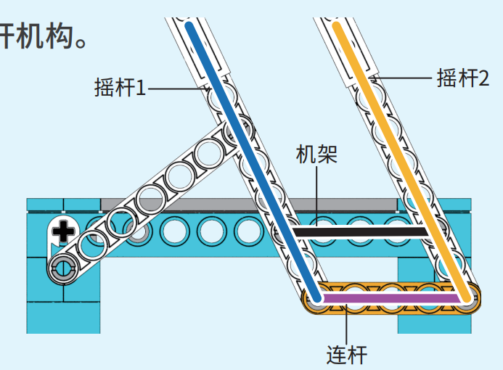
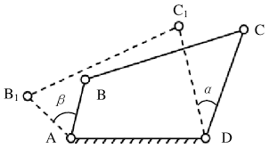
Double rocker mechanism
The double rocker mechanism which is a four-bar linkage mechanism where both links are rockers.

Slide 9
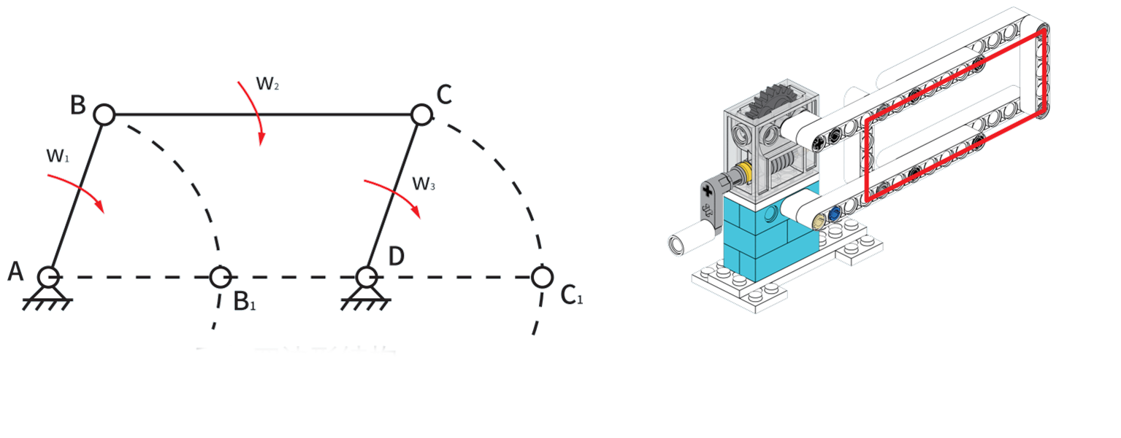
Parallelogram structure
A closed figure on a plane composed of two sets of parallel line segments is called a parallelogram. A planar linkage mechanism with its components forming a parallelogram.

Slide 10
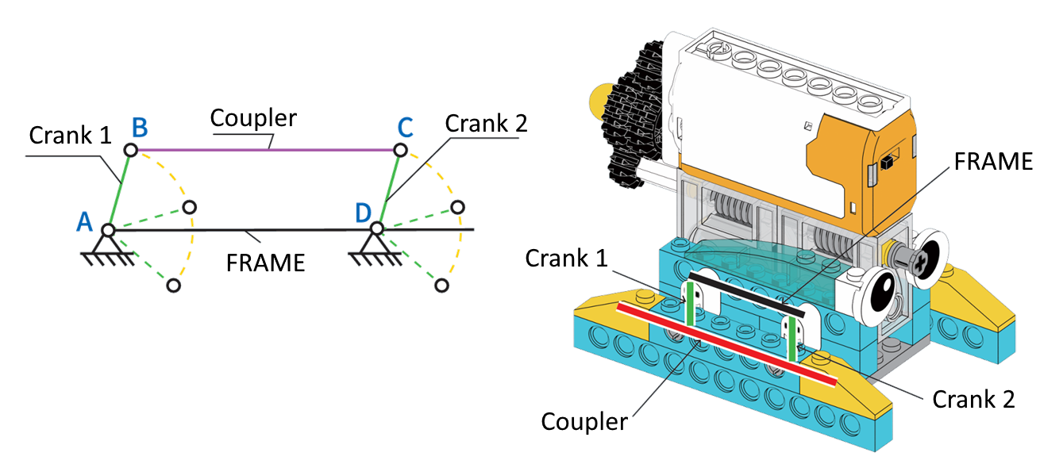
Parallel Double-Crank Mechanism
In a parallel double-crank mechanism, the two crank arms are equal in length, and the connecting rods and frame are also equal in length, forming a parallelogram.
When the driving crank rotates in a uniform circular motion, the driven crank rotates at the same angular speed and in the same direction. As a result, the connecting rod moves in a straight, parallel path.

