Slide 1
Sliding friction

Slide 2
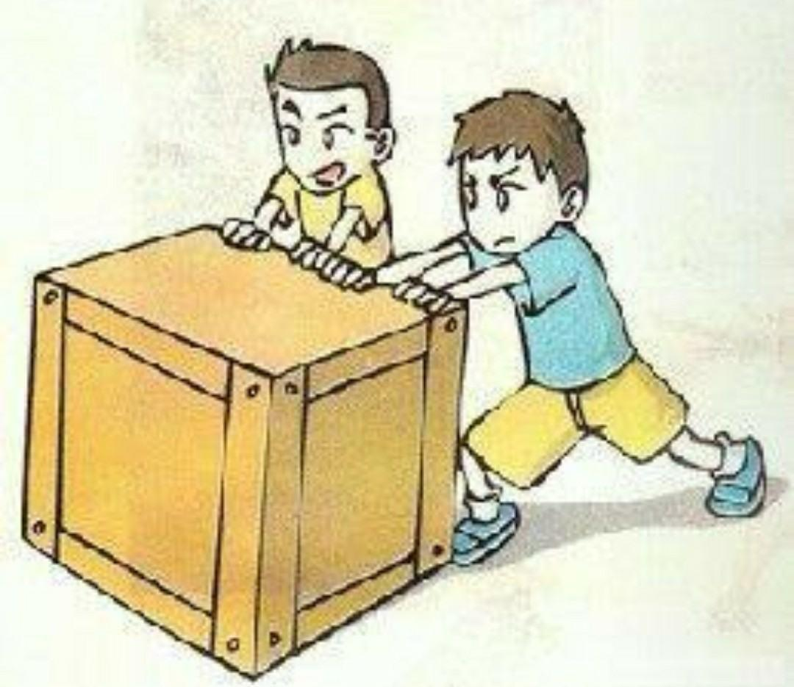
Sliding friction
When objects slide against each other, a force is created that resists their movement.
The amount of sliding friction depends on how rough or smooth the surface of the objects is. Rough surfaces create more sliding friction, whereas smooth surfaces create less.
Direction of the motion
Pushing force
Friction

