Slide 1
Cam Mechanism

Slide 2
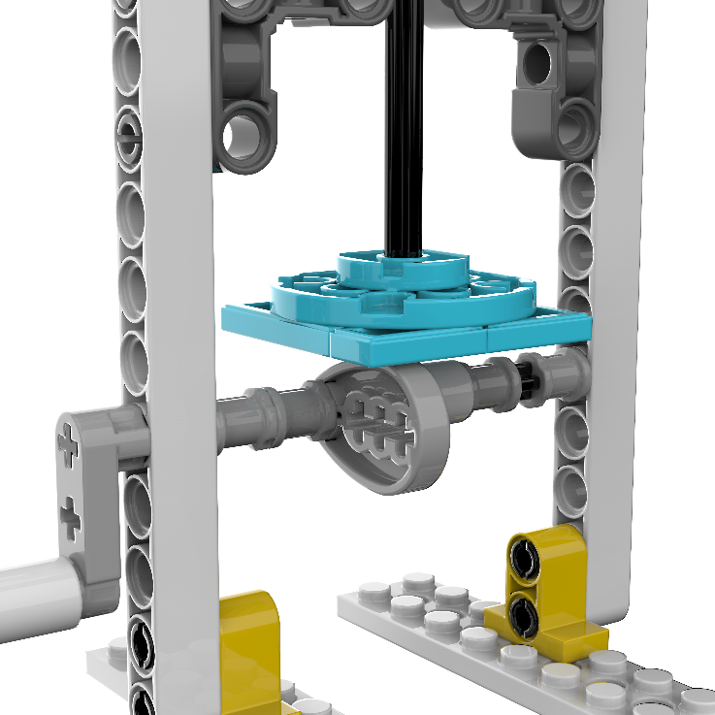
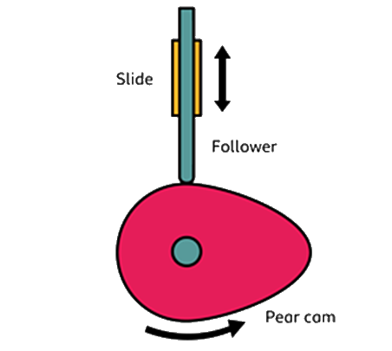
Cam mechanism
A cam mechanism is a mechanical device that converts rotary motion into linear or reciprocating (back and forth) motion. Rotary. Rotary is where objects or components move in a circular path or spin around a central point. Linear motion.

Slide 3
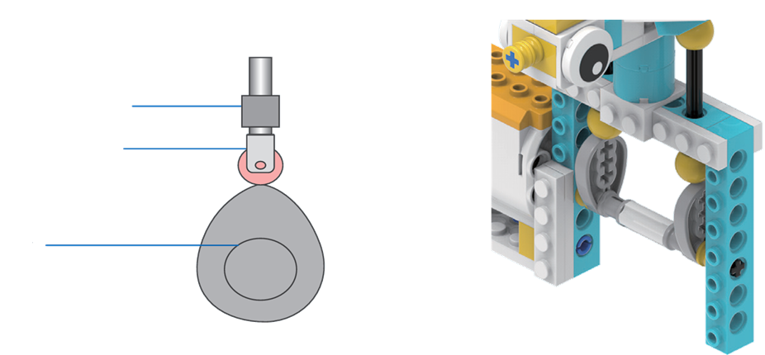
Cam Mechanism
A cam mechanism is a special machine part that helps things move in a stop-and-go way.
It has three main parts:
A cam (the driver that spins)
A follower (the part that moves)
A frame/ (the base that holds everything)
When the cam turns at a steady speed, it pushes the follower to move up and down or back and forth—kind of like how a music box or a hopping toy works!
Frame
Follower
Cam

