Slide 1
Rack and Pinion

Slide 2
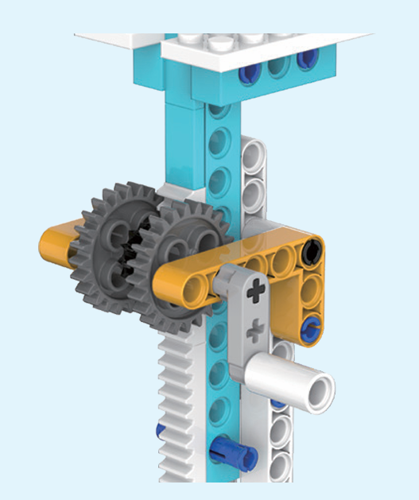
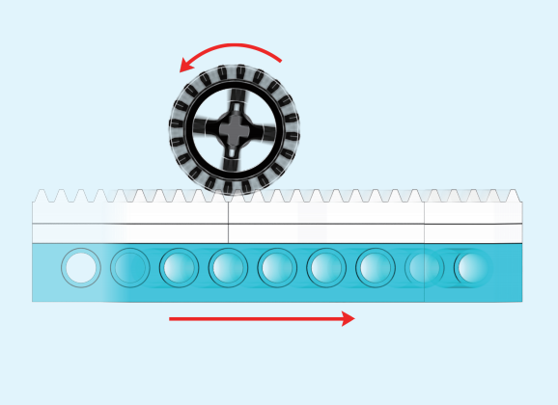
Rack and pinion
Rack and pinion
The jack applies a rack and pinion mechanism, and the rotary motion is converted into linear motion through the rack and pinion.

